Slide 1
Data Structures & Algorithms (CSC-214)
Lecture 0: Introduction & Orientation

Slide 2
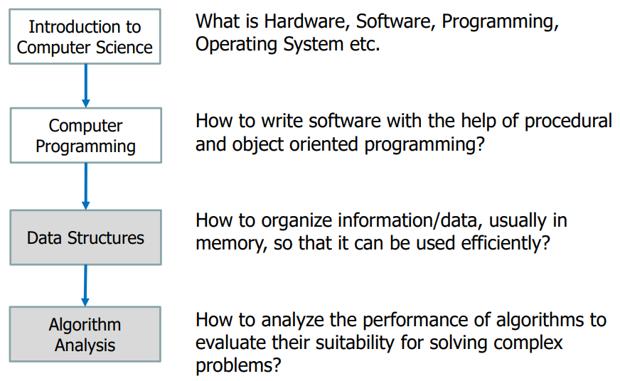
General Overview

Slide 3
Some Rules
• Raise your hand before asking any question – Wait for the permission
• Never ever miss a class – No retakes
• Never ever “sleep” in the class – You might miss a quiz
• Never use mobile phone in this class – Violators will be penalized
Above all, whatever you do, please do not disturb others

Slide 4
Dishonesty and Plagiarism
Any kind of cheating will be considered serious offense
All parties involve in cheating will get 0 marks
Exams, quizzes, assignments, projects

Slide 5
Course Information
GCR code: 7e5qgu5
Email: hamna.anwar@bnu.edu.pk

Slide 6
Why is this course crucial?
Pre-requisite course:
Design and analysis of Algorithms (semester 5)
Operating Systems (semester 6)
If you fail Data structures, your degree will be delayed by 6 months, guaranteed! ☹
Why students fail this course?
Do not study every week
Do not attend classes
Do not practice given problem sets
Drop out due to low attendance
Miss Quizzes/Assignments

Slide 7
Course Format & Division of Marks
3 credit lecture (2 classes per week)
Quizzes – 15%
6 – 7 quizzes, ALL accounted
Appeal within 7 days of marks being posted. Afterwards, finalized
Midterm Test – 25%
Project – 20%
Individual/group, evaluation at end of semester
Final Exam – 40%

Slide 8
What is a Data Structure?
In a general sense, any representation that is used for storing information is a data structure
Example: integers, structures, classes, arrays, etc.
More typically, a data structure provides a way for organizing a collection of data items
Storing, accessing and modifying data items
Most data structures have associated algorithms to perform operations on data
Search, insert, remove etc.
We need methods of organizing large amounts of data
Program and underlying structure which holds the data can add to the inefficiency esp if input data is large

Slide 9
Costs and Benefits
Each data structure requires
Space for storing data items
Time to perform each basic operation
Programming efforts
Cost of a data structure
Time and space resources it consumes
Choice of data structure depends on many factors
Type of data
Frequency with which various data operations are applied
Hard to define data structure that performs better in all situations
Time and space tradeoff

Slide 10
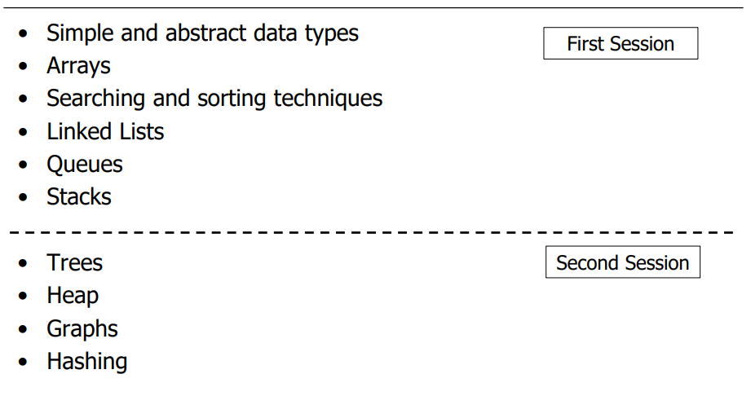
Course Outline & Schedule
Algorithm analysis will be covered intuitively with each data structure

Slide 11
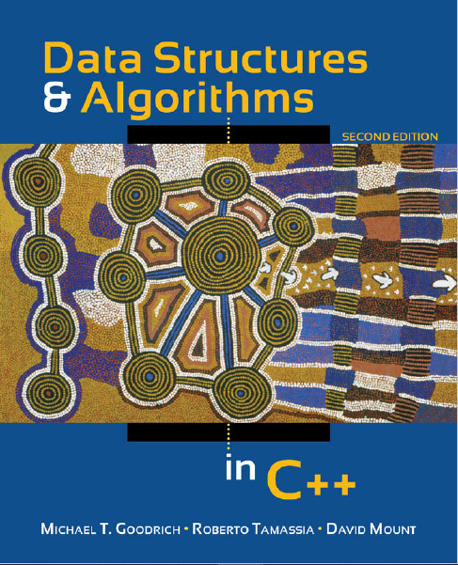
Text Book
Data Structures & Algorithms in C++
Second Ed.
Softcopy available

Slide 12
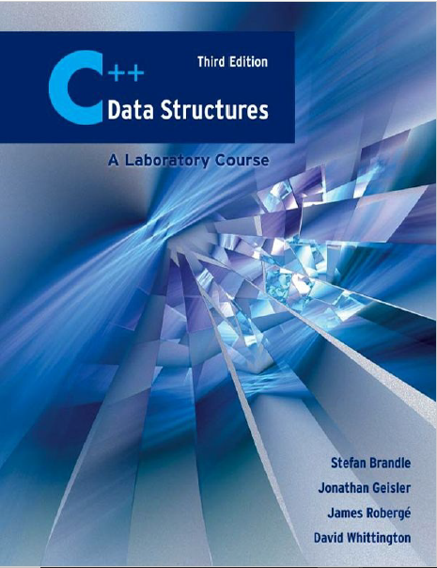
Text Book
C++ Data Structures: A Laboratory Course
Third Ed.
Soft copy available

Slide 13
Any Questions?

